Slide 1
Process Intelligence: Streamlining with Structure & Smart Technology
Dr. Elif Elcin Gunay
Supply Chain &Operations Management

Slide 2
Process Intelligence: Streamlining with Structure & Smart Technology
Explore how to simplify and standardize complex processes, uncover inconsistencies, and leverage AI for smarter, faster workflows.
• Understand process mining and its role in improving operational efficiency
• Identify bottlenecks in a process
• Analyze the impacts of those bottlenecks on final throughput
• Evaluate strategies for reducing bottlenecks and improving process performance
• Select appropriate strategies to streamline and optimize processes

Slide 3

DELETE THIS SLIDE – ONLY FOR DEVELOPMENT
Anvil Graphic
Use this graphic on any key slides OR to reinforce learning objectives

Slide 4
Outline

Slide 5
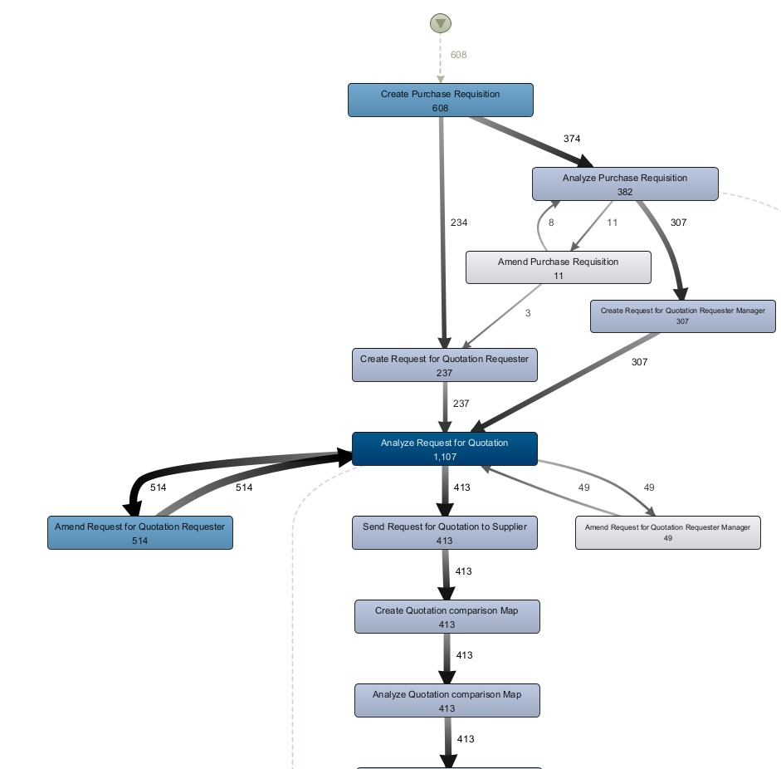
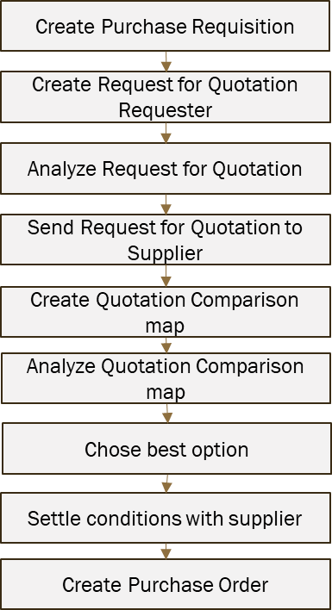
Overview of Process Mining
How do you perform your processes?
“Reference”
Process
“As-is”
Process
A gap often exists between the reference process and the actual process.
Process mining shows the real process based on actual data

Slide 6
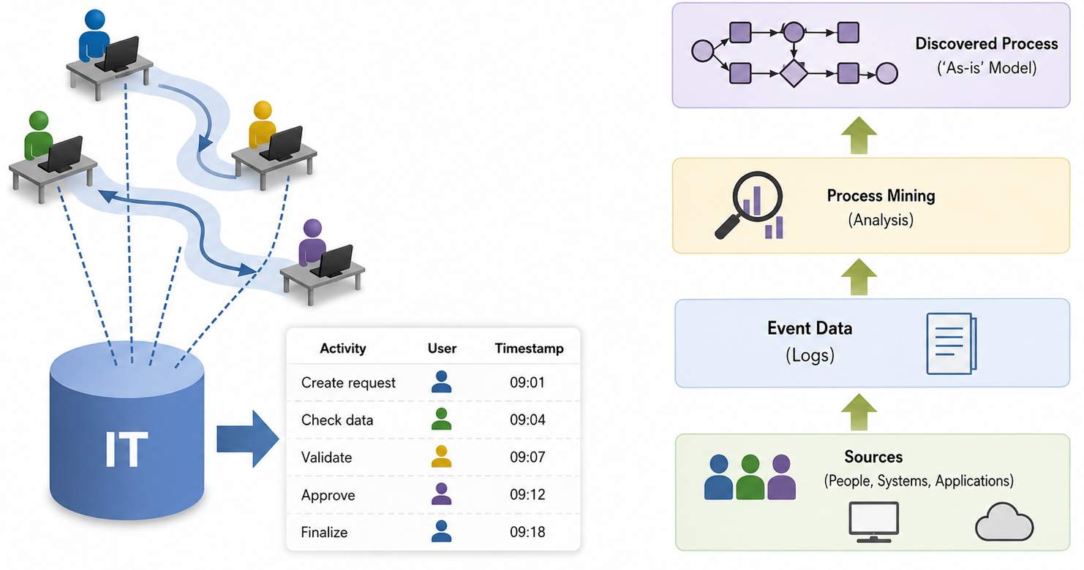
Overview of Process Mining
Leveraging Data to Understand Processes
Process mining extracts the real workflow automatically from existing IT data
Process mining uses these digital traces to:
discover how processes actually work,
identify delays or bottlenecks,
compare real processes with designed workflows,
and improve operational efficiency.
Huge amounts of this historical process data are continuously generated for daily operations.

Slide 7
Overview of Process Mining
Information systems
Continuous improvement
Event data
Process Diagnostics (as-is models)
Conformance performance diagnostics
Predictions
Better process decisions
Discovery algorithms
Replay with enriched data
Interact with these models
Observe
  Frequent behavior
  Outlier behavior
Modify
  To-be models
Performance metrics
  Bottleneck
  Highest waiting times
  Congestion
Redesign the process
Compare processes and make predictions
Van Der Aalst, W. (2012). Process mining. Communications of the ACM, 55(8), 76-83.
van der Aalst, W. M. P. (n.d.). Want to do a process mining project? https://www.vdaalst.com/slides/Want-to-do-a-process-mining-project.pdf

Slide 8
Overview of Process Mining
We start with event data
Case | Activity | Resource | Time Stamp | Product | Price | Quantity
… | … | … | … | … | … | …
3850 | Place Order | Customer_A | 7/1/2025 9:00 | Laptop | 1200 | 1
3852 | Pay | Customer_A | 7/1/2025 9:10 | Laptop | 1200 | 1
3850 | Prepare Delivery | Staff_B | 7/1/2025 10:00 | Laptop | 1200 | 1
3850 | Confirm Payment | Finance_C | 7/1/2025 10:15 | Laptop | 1200 | 1
3851 | Place Order | Customer_D | 7/1/2025 11:30 | Smartphone | 850 | 2
3852 | Prepare Delivery | Staff_E | 7/1/2025 12:20 | Smartphone | 850 | 2
… | … | … | … | … | … | …
event data =
caseID +
activity name+
timestamp + …
Trace → for each event, we extract an activity sequence
Event (order) 3850
Place order
Send invoice
Pay
Prepare delivery
Make delivery
Confirm payment
Event (order) 3851
Place order
Send invoice
Cancel order
Event (order) 3852
Place order
Send invoice
Pay
Prepare delivery
Confirm payment
Make delivery

Slide 9
Closer look
Whole data set (event log)
Case | Activity | Resource | Time Stamp | Product | Price | Quantity | …
… | … | … | … | … | … | … | …
3850 | place order | Customer_A | 7/1/2025 9:00 | Laptop
3852 | pay | Customer_A | 7/1/2025 9:10 | Laptop
3850 | prepare delivery | Staff_B | 7/1/2025 10:00 | Laptop
3850 | prepare delivery | Finance_C | 7/1/2025 10:15 | Laptop
3851 | confirm payment | Customer_D | 7/1/2025 11:30 | Smartphone
3852 | pay | Staff_E | 7/1/2025 12:20 | Smartphone
#61,289 events
#13,289 cases
# 6 activities
#7523 x
#1523 x
#3589 x
#23 x
#9 x
Place order
Send invoice
pay
Prepare delivery
make delivery
Confirm payment
Place order
Send invoice
Cancel order
Place order
Send invoice
pay
Prepare delivery
Confirm payment
make delivery
Place order
pay
Send invoice
Prepare delivery
Make delivery
Confirm payment
Place order
pay
Send invoice
Prepare delivery
Confirm payment
Make delivery

Slide 10
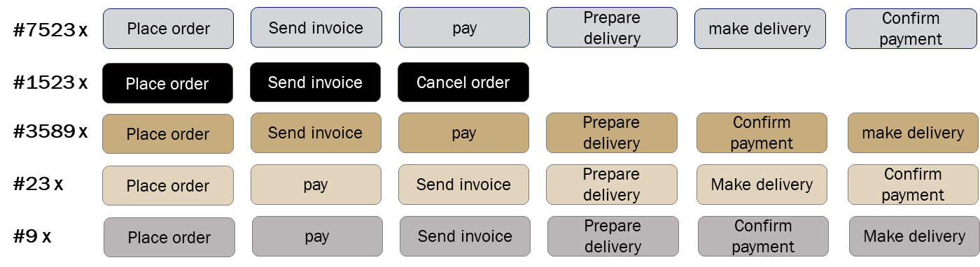
Closer look
This is the model describing how your processes are executed in reality – without doing any modelling
This data is used to automatically construct process models

Slide 11
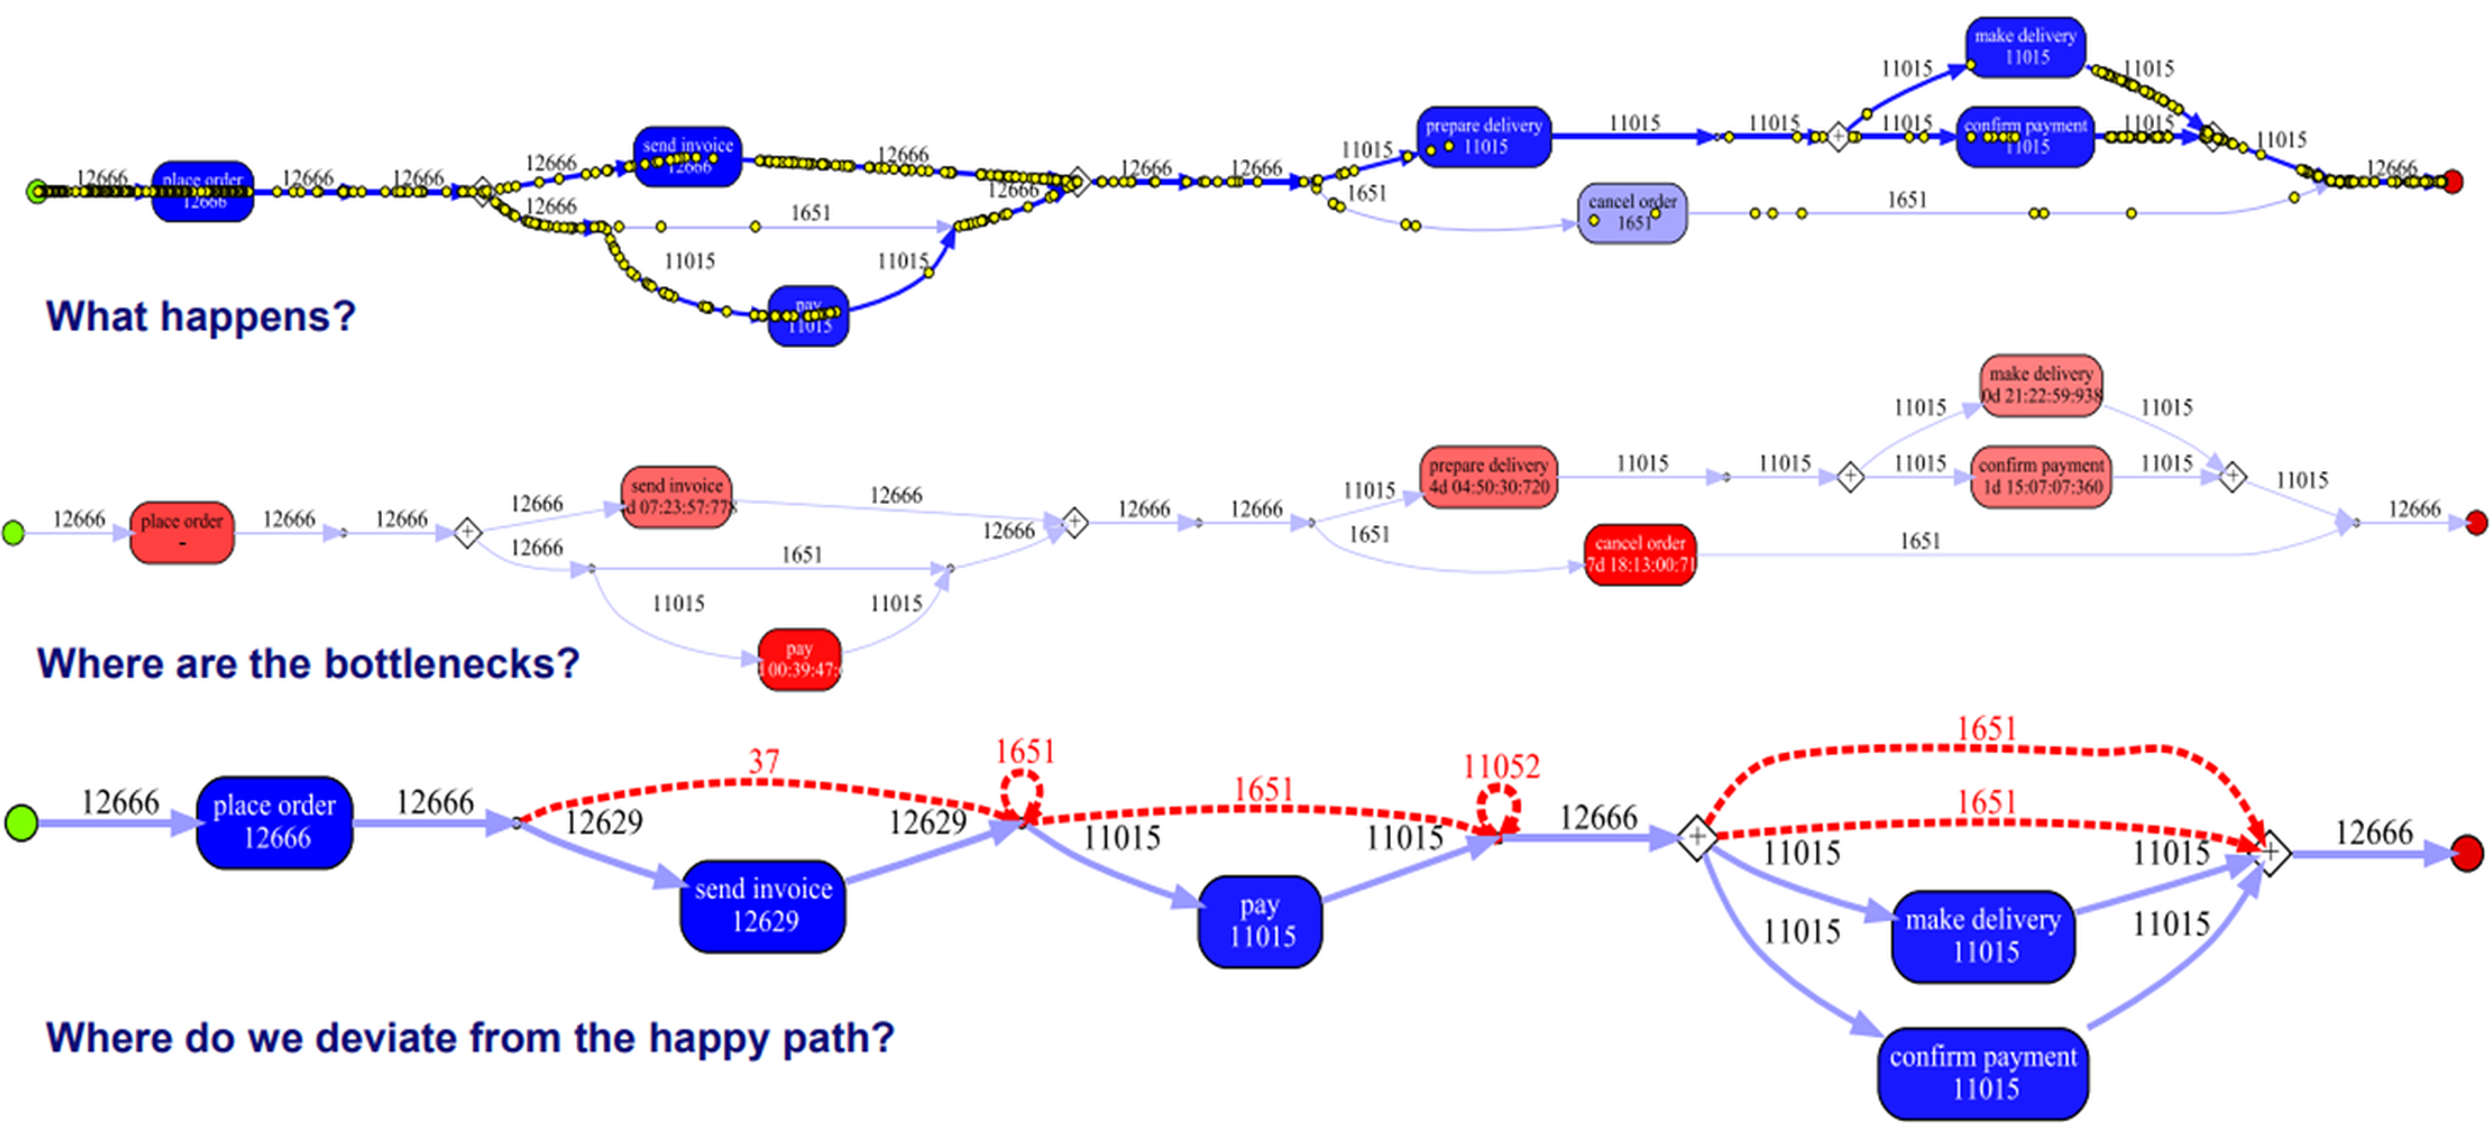
Why do you want to do this?
Frequencies
What is happening?
Bottlenecks
Control flow
Where are bottlenecks?
Where deviations from reference model occurs?

Slide 12
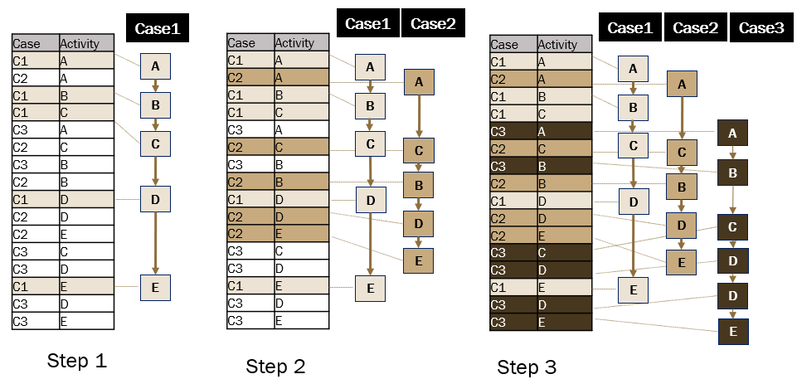
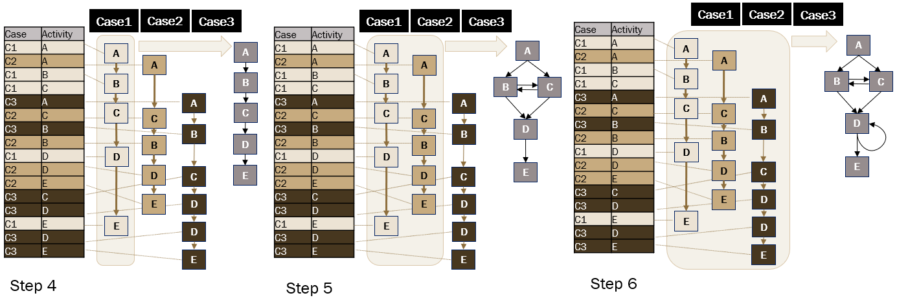
How do we move from event logs to process models?
Algorithms
Alpha algorithm
Fuzzy Miner
Heuristic mining
Genetic Process Mining
Region-based Mining
Inductive Mining
Step 1
Step 2
Step 3
A
B
C
D
E
Step 4
Step 5
Step 6

Slide 13
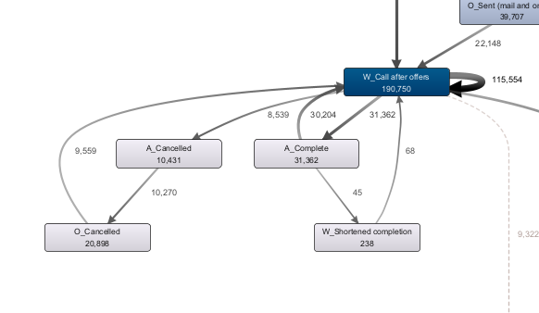
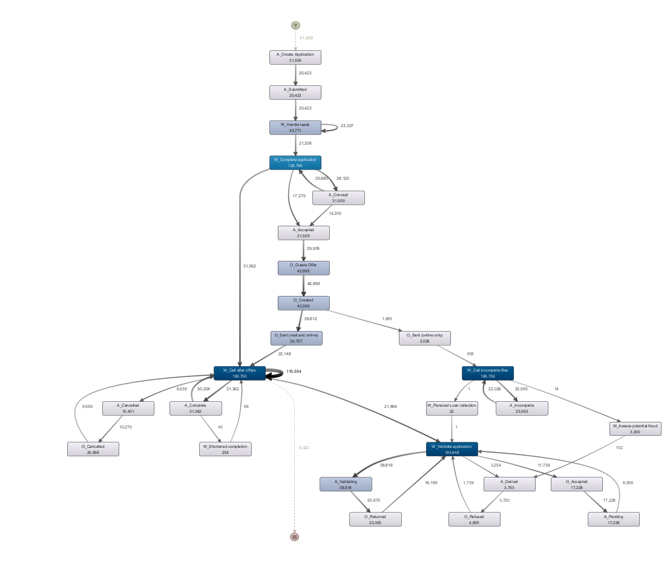
How does process mining help?
After you upload data, process mining software will automatically discover your process just from the historical data
This is the start of your process
So many rework

Slide 14
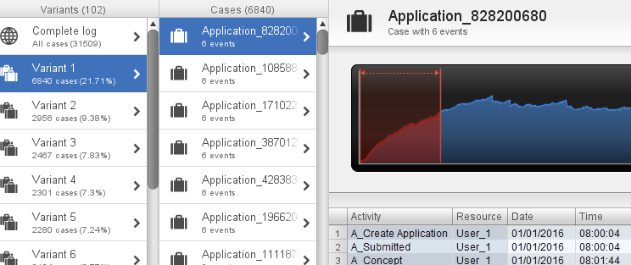
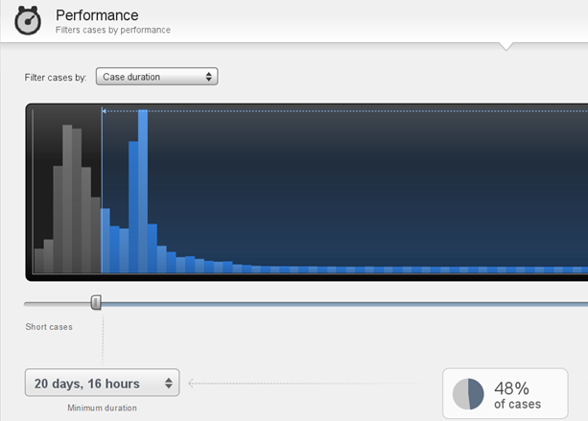
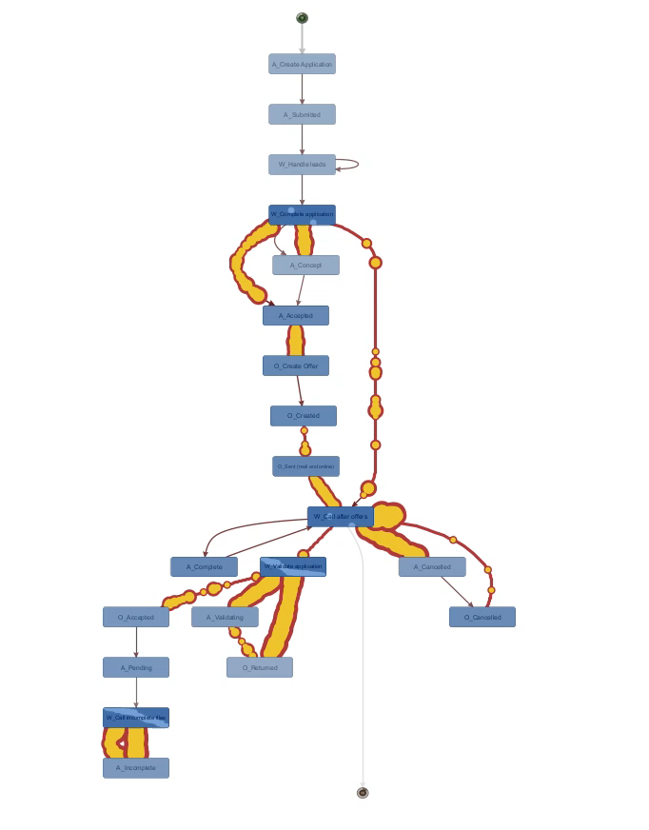
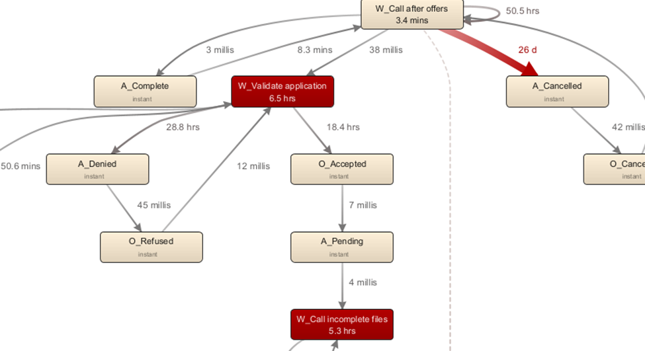
How does process mining help?
Select the variants
Filter based on performance
Animate the Process
Visualize bottlenecks

Slide 15
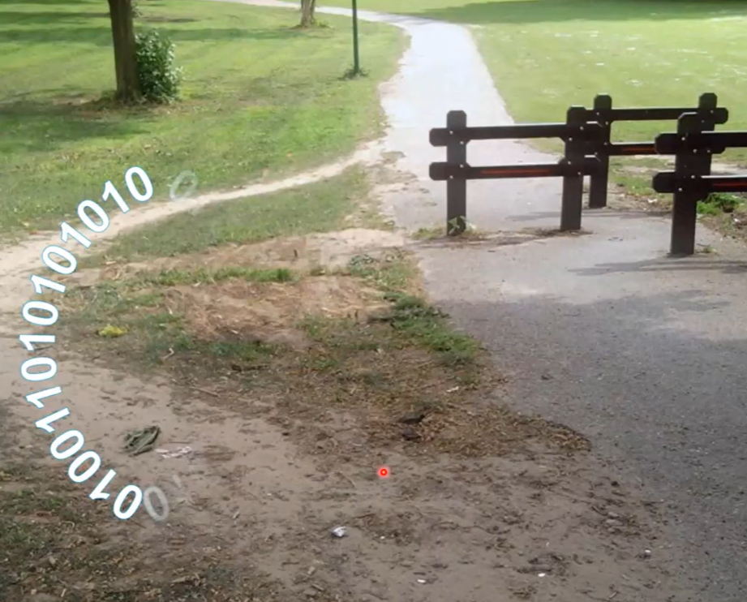
How does process mining help?
Not only data also processes matter
What is the process people (customer, student, patient,..) follow?
Where are the bottlenecks?
Where do people/machines deviate from the reference process?
Where is the waste?
What factors are influencing a bottleneck?
Can we predict problems? (any delay, deviation, etc.)
How to redesign the process/organization?

Slide 16
Part 2
Switching gears - transition from “as-is” to “to-be”?

Slide 17
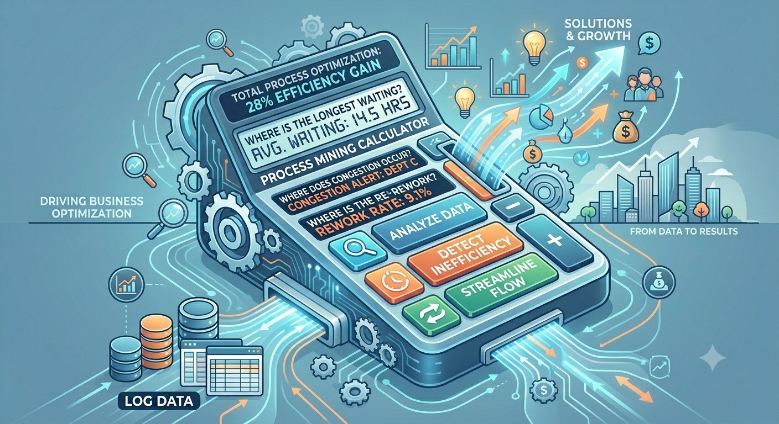
Process mining as a process calculator …
Process mining uses data from real business processes instead of relying on interviews or observations.
It complements improvement approaches such as Lean, Six Sigma, Business Process Management (BPM), and Theory of Constraints.
It helps organizations detect problems more quickly and with greater accuracy.

Slide 18
How can we move from “as-is” to “to-be”?
Changing the location of the bottleneck
Balancing the workload among resources
Increasing bottleneck capacity
Reduce waiting
  Control service process, e.g. standardize activities, reduce variation, improve quality
  Pool resources

Slide 19
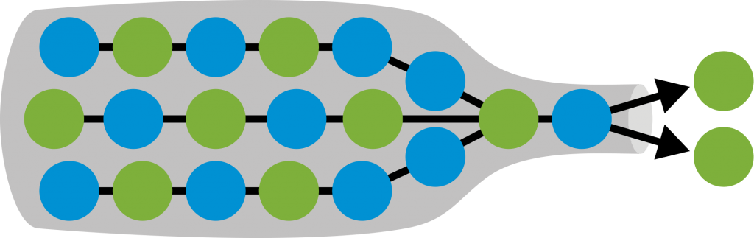

Identify Bottleneck
The overall process capacity is determined by the resource with the smallest capacity.
Bottleneck:
  Stage with the smallest capacity, or the longest processing time.
Process capacity:
  How much the process can produce in a given time
  Determined by bottleneck capacity
$$\text{Process} \text{capacity}=\min\left\{\text{capacity} \text{of} \text{resource}\text{ 1, …, }\text{capacity} \text{of} \text{resource} n\right\}$$
$$\text{=}\text{Bottleneck} \text{resource} \text{capacity}$$
Bottleneck (capacity)
Input
Output
Cachon, G., & Terwiesch, C. (2008). Matching supply with demand (Vol. 20012). New York: McGraw-Hill Publishing.

Slide 20

GOAL
Business novel introducing the Theory of Constraints (TOC)
Story of Alex Rogo, a plant manager with 90 days to save his factory
Shows how to identify and manage bottlenecks (constraints)
Focuses on improving throughput, inventory, and operating expense
Key takeaway: A system’s performance is limited by its constraint
The Goal, by Eliyahu M. Goldratt

Slide 21
Understanding the Process
Dependent events
All it means is that one operation has to be done before a second operation can be performed.
  The customer service representative must first collect and verify the customer documents before the credit analyst can evaluate the applicant’s credit worthiness.
  The credit analyst must complete the risk assessment before the loan manager can approve or reject the loan.
Each step depends on the completion of the previous step in the process.
Step 1
Step 2
. . .
Step n-1
Step n

Slide 22
Understanding the Process
Statistical Fluctuations
Statistical fluctuations are natural variations that occur in a process, even when the average performance stays the same.
In any system, people, machines, or activities do not operate at exactly the same speed or consistency all the time.
Small differences in timing, speed, or performance accumulate and affect the overall flow of the system.
  One worker may take slightly longer to complete a task.
  One customer may require extra processing time.
  Even small variations can increase delays and waiting times throughout the system.
Capacity is the same for each step: 6 units/hr
Step 1
Step 2
. . .
Step n-1
Step n
? ? ? ? ?

Slide 23

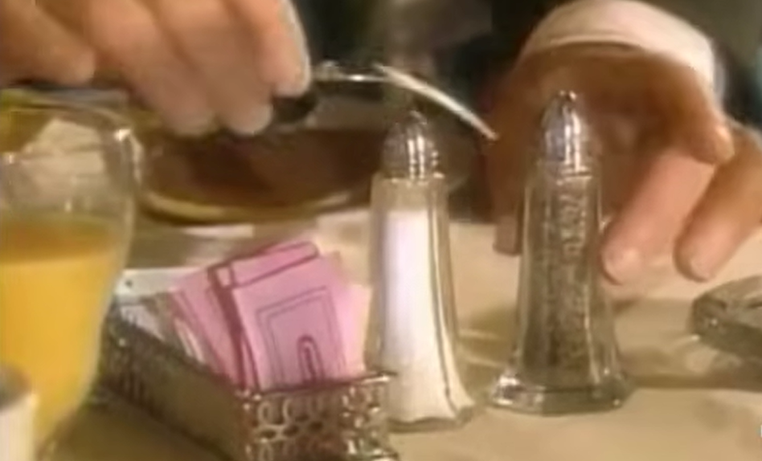

Understanding the Process
A conversation between Alex and Jonah about plant inefficiency, Jonah explains two fundamental concepts: dependent events and statistical fluctuations.
[ Watch the video ] 0' - 3' 16''
Dependent events – one can not start a process before previous process is finished
Statistical fluctuations –
variations that occur in any process and make actual performance differ from average performance
With all this advanced technology, why are things still so slow?

Slide 24
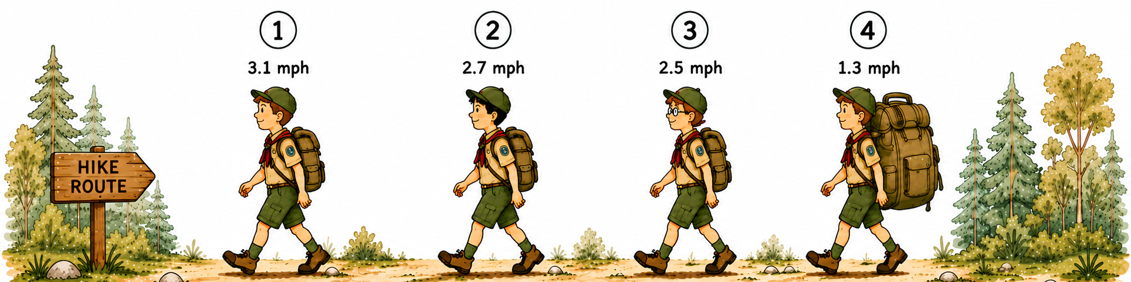
BOTTLENECK ANALYSIS
Scout hiking
The scouts must walk in sequence, with each scout depending on the one a head.
The goal is for the entire group to arrive at the destination together.
What is your strategy?
Scout 4 is the slowest
Scout 1 is the fastest
As they walk, how distance between scouts’ change?
What is your strategy to achieve the goal?
Look for your bottleneck!
[ Watch the video ] 3’ 30‘’ -

Slide 25
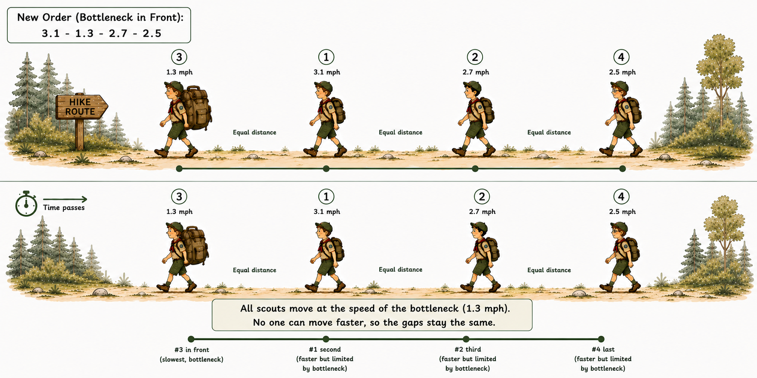
BOTTLENECK ANALYSIS - SOLUTIONS
Change the order – What if Herbie leads?

Slide 26
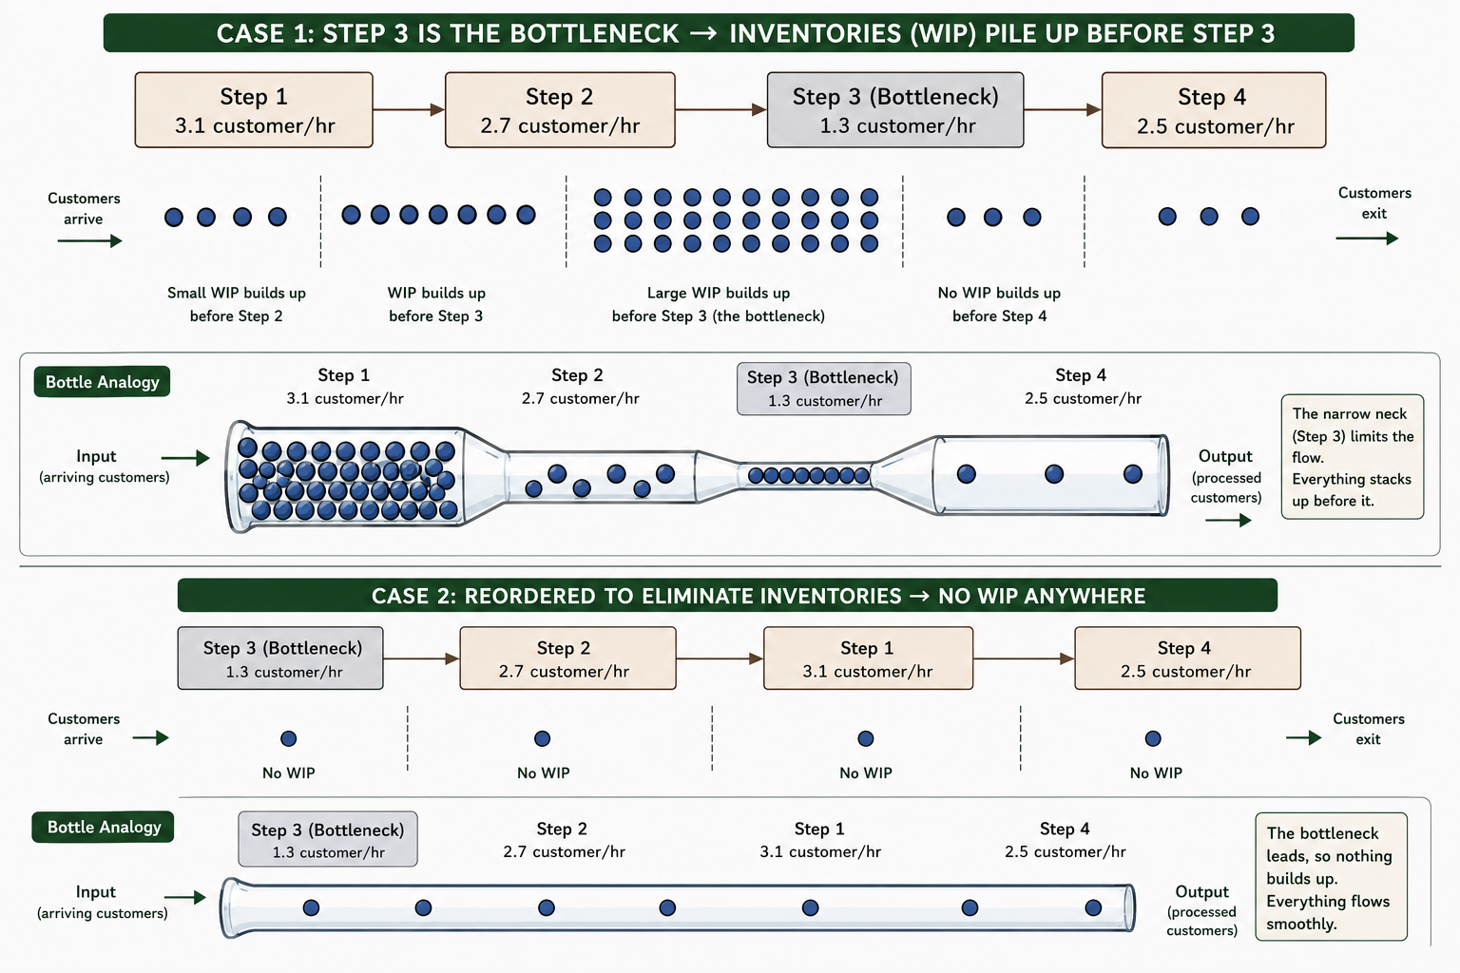
Change the order – What if Herbie leads?
* A bottleneck determines system throughput
*Its location determines where inventory builds up
and how variability spreads through the process.
How does this insight apply in real process?
Assume we can change the order of the tasks
WIP builds up!
WIP builds up!
Step 1
3.1 customer/hr
Step 2
2.5 customer/hr
Step 3
1.3 customer/hr
Step 4
2.7 customer/hr
Input
(arriving customers)
Output
(processed customers)
Step 3
1.3 customer/hr
Step 2
2.5 customer/hr
Step 1
3.1 customer/hr
Step 4
2.7 customer/hr
Input
(arriving customers)
Output
(processed customers)

Slide 27
Change the order – What if Herbie leads?
How does this insight apply in real process?
Reorganize everything so the resource with the least capacity would be first in the routings. All other resources would have gradual increases in capacity to make up for the statistical fluctuations passed through dependency.
  Sometimes we can not do that. “The sequence of operations has to stay the way it is” (dependent events)
Step 1
3.1 customer/hr
Step 2
2.5 customer/hr
Step 3
1.3 customer/hr
Step 4
2.7 customer/hr
Step 3
1.3 customer/hr
Step 2
2.5 customer/hr
Step 1
3.1 customer/hr
Step 4
2.7 customer/hr

Slide 28
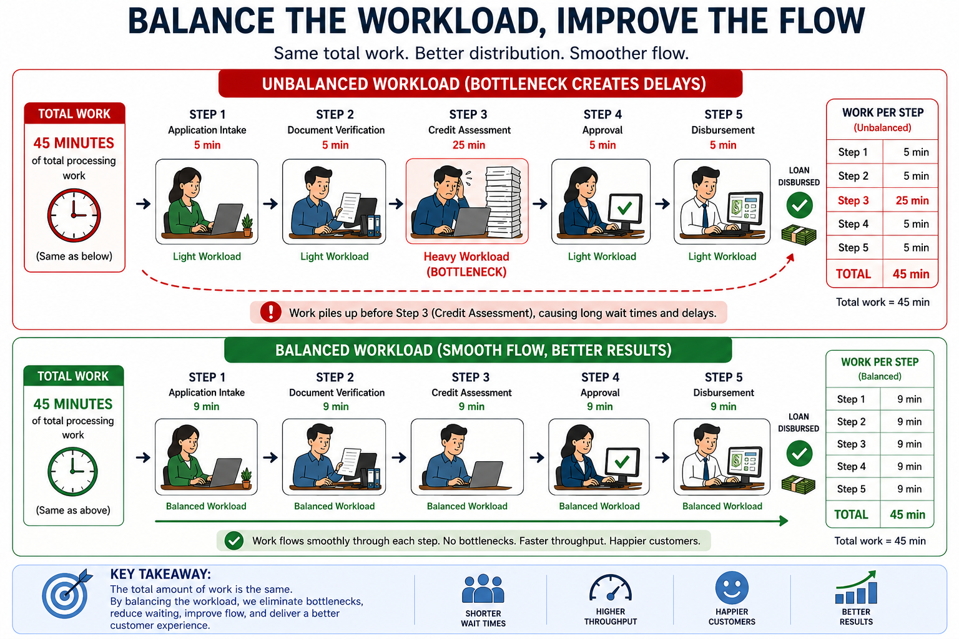
Hey HERBIE: Go FASTER!
LESSON 1: Whatever the bottleneck can process in an hour determines what the entire service system can deliver in an hour.
Reduce the workload on the bottleneck resource.
Unbalanced workload
Balanced workload

Slide 29
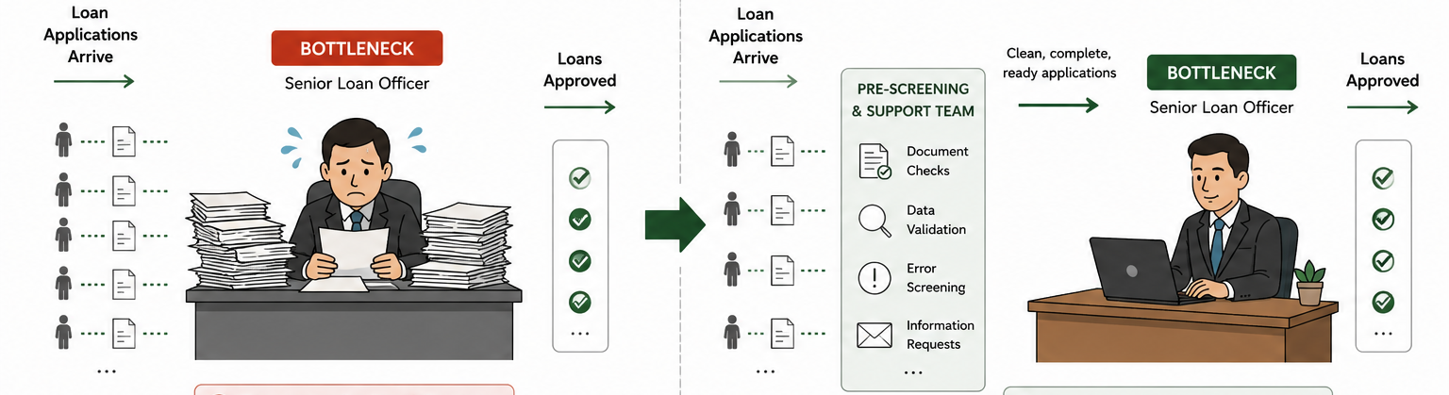
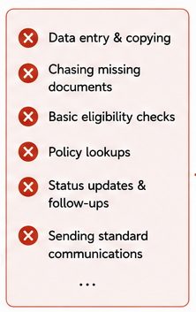
Hey HERBIE: Go FASTER!
LESSON 1: Whatever the bottleneck can process in an hour determines what the entire service system can deliver in an hour.
Reduce the workload on the bottleneck resource.
Ensure the bottleneck focuses only on high-value activities that directly improve customer service and process throughput.
  Perform document checks, data validation, and error screening before work reaches the bottleneck.
Follow-ups, emails, low-value tasks.
Longer cycle times.
High-value added tasks.
Faster approvals. Happy customers

Slide 30
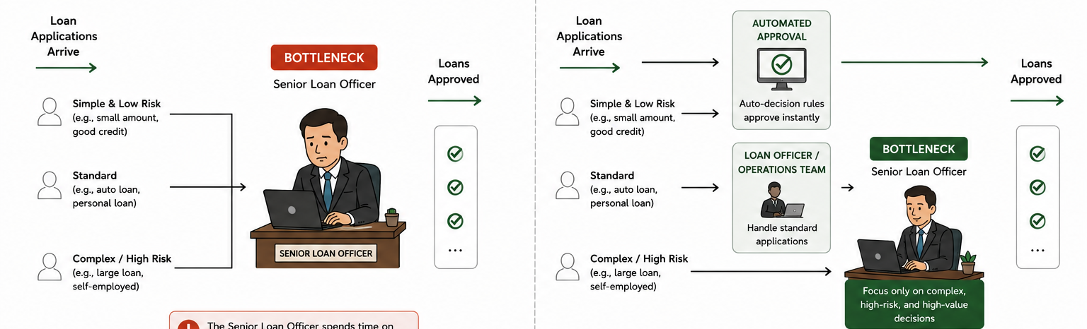
Hey HERBIE: Go FASTER!
LESSON 1: Whatever the bottleneck can process in an hour determines what the entire service system can deliver in an hour.
Identify tasks or customers that do not need to go through the bottleneck. Route or resolve them outside the bottleneck
Spends time on simple, low-risk loans
Less time for complex cases
Bottleneck focuses on what truly needs their expertise. Better decisions. Faster approvals

Slide 31
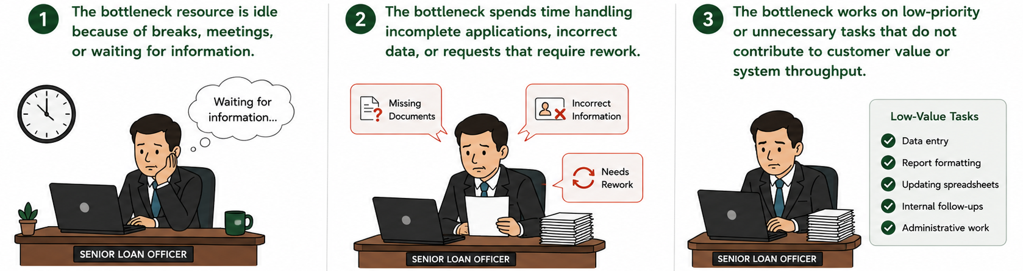
Protect the bottleneck’s time
Summary
Make sure bottleneck’s time is not wasted
  The bottleneck resource is idle because of breaks, meetings, or waiting for information.
  The bottleneck spends time handling incomplete applications, incorrect data, or requests that require rework.
  The bottleneck works on low-priority or unnecessary tasks that do not contribute to customer value or system throughput.

Slide 32
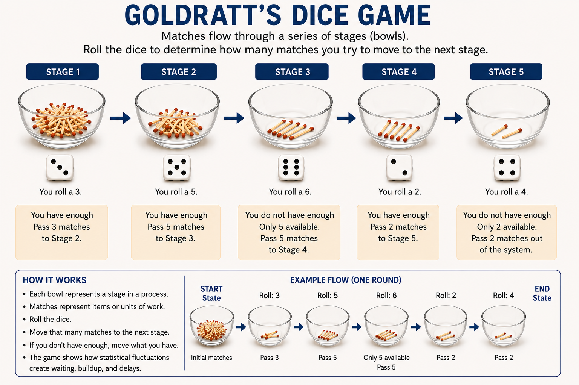
Goldratt’s Dice Game

Slide 33
SIMULATION
Commercial Underwriting Operations
DOC VERIFY
Capacity: -
Queue Start: 0
Processed: -
Backlog: 0
CREDIT SCORE
Capacity: -
Queue Start: 0
Processed: -
Backlog: 0
APPRAISAL
Capacity: -
Queue Start: 0
Processed: -
Backlog: 0
KYC REVIEW
Capacity: -
Queue Start: 0
Processed: -
Backlog: 0
SIGN-OFF
Capacity: -
Queue Start: 0
Processed: -
Backlog: 0
DAILY APPROVED
-
LOAN DISBURSED
-
APP INTAKE
Daily Capacity is simulated by a 6-sided die. The capacity is between 1 and 6 files per day.
Rules:
Every day, each stage looks at its waiting files and its capacity for that day
Every day, you roll a standard 6-sided die.
The number you roll is your capacity for that day (how many units you are capable of processing).
You can only move units up to your rolled capacity if you actually have that many units sitting in front of you.
Any leftover files that exceed that day’s capacity get stuck and wait at that stage until the next day.

Slide 34
SIMULATION - Commercial Underwriting Operations
[ Link to Simulation worksheet ]
Scenario 1: Baseline (No Bottleneck)
  Every stage’s daily capacity is represented by a standard 6-sided die (values 1–6).
Scenario 2: Middle Stage Constraint (Appraisal BN)
  Due to a shortage of certified real estate appraisers, Stage 3 is limited to a max capacity of 3 per day, while all other stages retain their normal 6-sided die capacity.
Scenario 3: First Stage Constraint (Intake BN)
  An IT system glitch drops Stage 1 Document Verification to a maximum capacity of 3 files per day. Stages 2 through 5 retain full 6-sided capacity.
Scenario 4: Last Stage Constraint (Sign-off BN)
  The Senior Credit Committee is overwhelmed, dropping their capacity down to a maximum of 3 applications per day. Stages 1 through 4 run at full 6-sided capacity.
Scenario 5: Dual Capacity Upgrade (Appraisal BN + Double Credit Capacity)
  In this scenario, we expand the capacity of a non-bottleneck stage while maintaining the original constraint at Stage 3, identical to Scenario 2

Slide 35
SIMULATION - Commercial Underwriting Operations
Take aways
The bottleneck determines the system’s maximum output (throughput).
The location of the bottleneck determines where work starts to pile up (WIP/inventory).
Work-in-process accumulates in front of the bottleneck.
Increasing the capacity of a non-bottleneck does not increase overall system output.
To improve throughput, focus on increasing the bottleneck’s capacity.

Slide 36
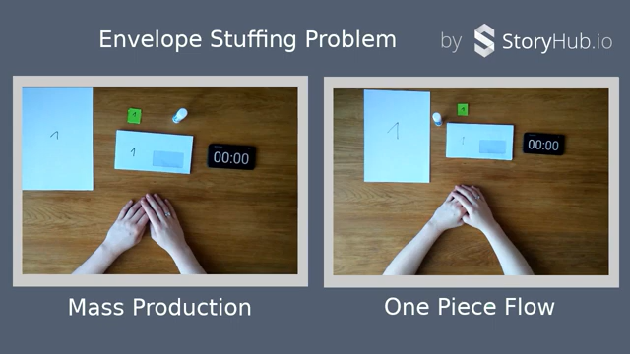
Reduce batch size
Which one is faster?
Steps:
1- Fold the letter
2- Put it in the envelope
3- Seal it
4- Stamp
  One piece flow
Reduces first-piece and overall production lead time
Enables faster detection of quality issues
Minimizes rework and waste
Enhances flexibility and responsiveness
The goal of minimum batch sizes is “one-piece flow”

Slide 37
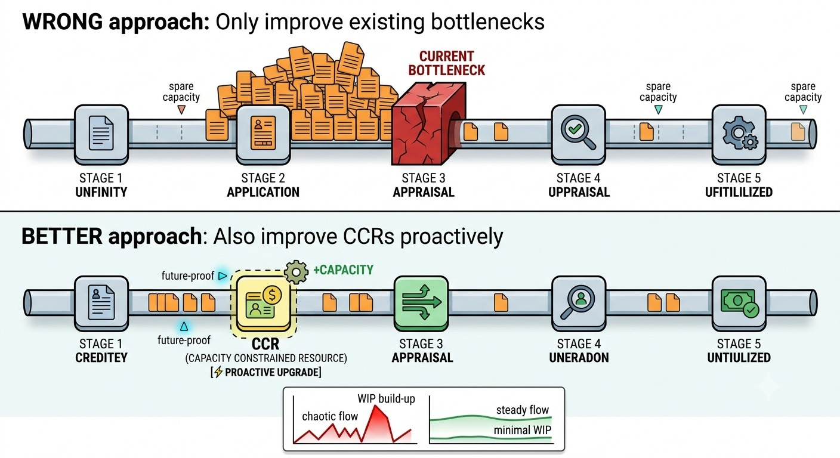
Proactive Approach
Today’s non-bottleneck can become tomorrow’s bottleneck
CCRs are “almost bottlenecks.” They still have some spare capacity, but not much. They may not handle statistical fluctuations.

Slide 38
Theory of Constraints Framework
Identify the Constraint - Find what is holding everything back
Exploit the Constraint - Use bottlenecks as efficiently as possible
Subordinate everything Else - Adjust all other parts of the system to support the bottleneck
Elevate the Constraint - If it’s still holding you back, add more capacity
Repeat the Process - Once one bottleneck is fixed find next one. Continuous improvement
Exploit the Constraint
Subordinate everything Else
Elevate the Constraint
Repeat the Process
Identify the Constraint

Slide 39
How can we move from “as-is” to “to-be”?
Changing the location of the bottleneck
Balancing the workload among resources
Increasing bottleneck capacity
Reduce waiting
  Control service process, e.g. standardize activities, reduce variation, improve quality
  Pool resources

Slide 40
How can we move from “as-is” to “to-be”?
Queuing
Queuing occurs when customers wait for service.
An average person throughout their lifetime spends five years waiting in lines and queues (The Fact Site, 2010).
Customers arrive for service at random intervals
Input:
Passengers in an airport
Customers at a bank
Patients at a hospital
Callers at a call center
Arrival Rate (Demand Rate)
(# flow units/time)
Buffer
Processing
Queue
Resources:
Check-in clerks at an airport
Tellers at a bank
Nurses at a hospital
Customer service representatives (CSR) at a call center
Service Rate (Capacity)
(# flow units/time)

Slide 41
Queuing
Variability Leads to Waiting Time
Average interarrival time = 5 min/customer
Average Service Time = 4.5 min/customer
1
2
3
Service
time
Customer | Arrival time | Service time
1 | 0 | 5
2 | 7 | 6
3 | 9 | 7
4 | 12 | 6
5 | 18 | 5
6 | 22 | 2
7 | 25 | 4
8 | 30 | 3
9 | 36 | 4
10 | 45 | 2
11 | 51 | 2
12 | 55 | 3
4
5
6
7
Wait
time
8
9
10
11
12
5
4
3
2
WIP
(Customers on Hold and in Service)
1
0
7:00
7:10
7:20
7:30
7:40
7:50
8:00

Slide 42
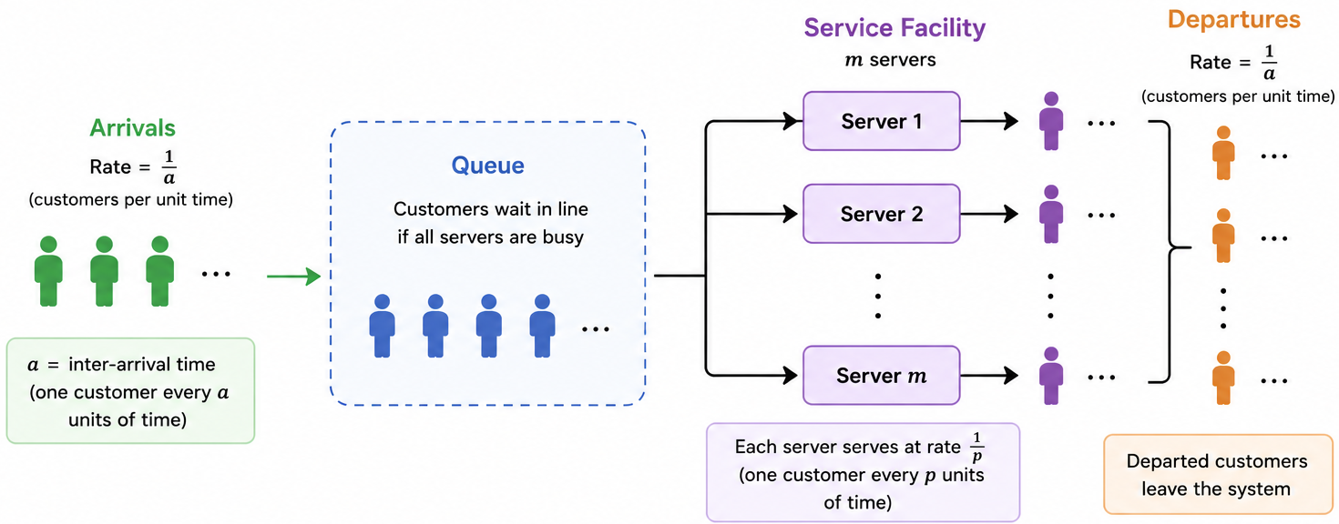
The design of a queuing system
Customer arrival
How long customers on average will wait?
Number of servers
Service time
Server utilization
System profitability
Customer experience

Slide 43
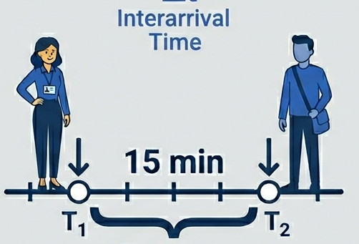
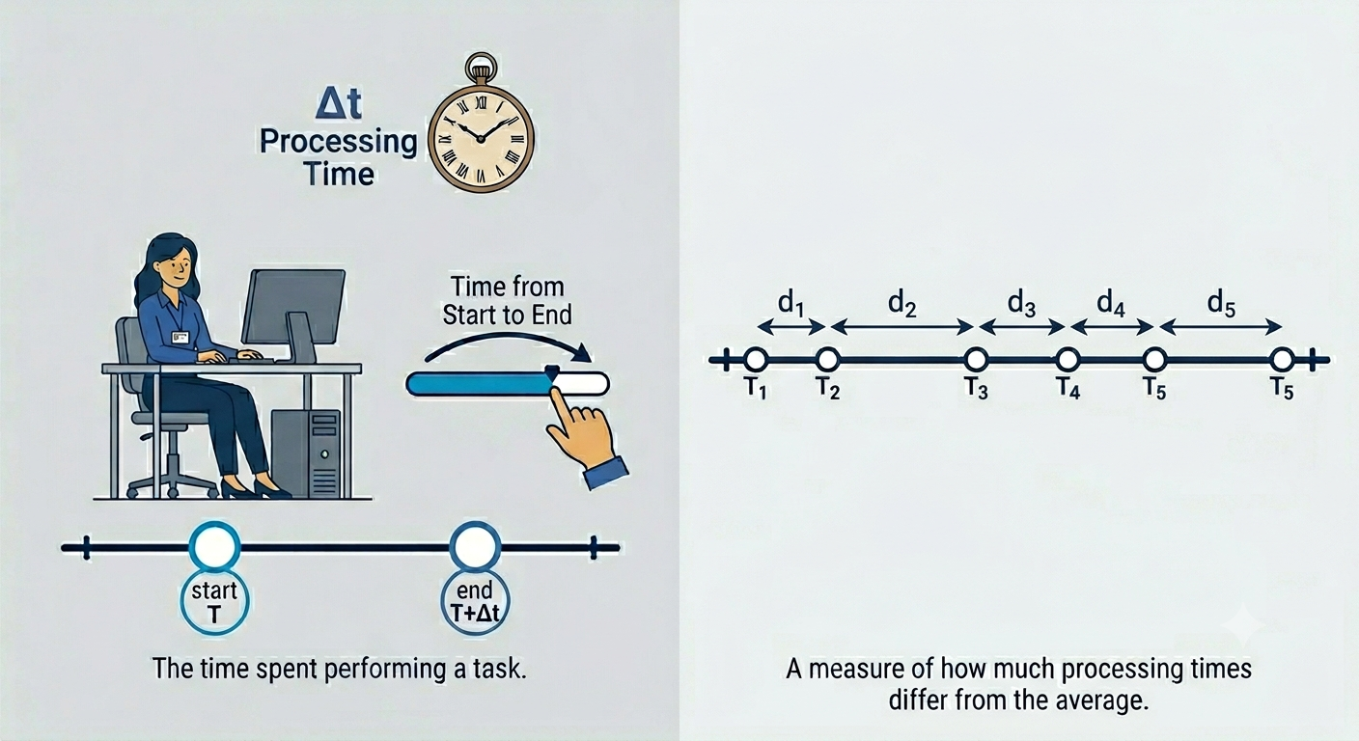
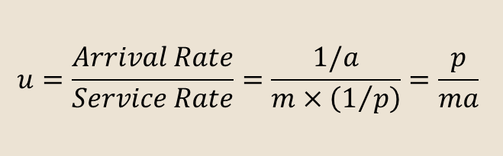
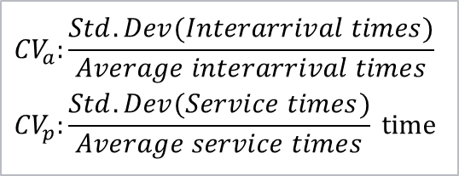
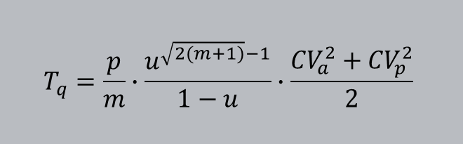

The design of a queuing system
Interarrival time
Utilization is a measure of server busyness.
$$u=\frac{Arrival Rate}{Service Rate}=\frac{1/a}{m×\left(1/p\right)}=\frac{p}{ma}$$
$$a:\text{Average} \text{interarrival} \text{time}$$
$1/a:\text{Interarrival} \text{rate}$
$$p:\text{Service} \text{time}$$
$$m:\text{Number} \text{of} \text{servers}$$
Service time
Average waiting time in the queue, $T_{q}$
$$T_{q}=\frac{p}{m}∙\frac{u^{\sqrt{2(m+1)}−1}}{1−u}∙\frac{{CV}_{a}^{2}+{CV}_{p}^{2}}{2}$$
$${CV}_{a}:\frac{Std. Dev(Interarrival times)}{Average interarrival times}$$
$${CV}_{p}:\frac{Std. Dev(Service times)}{Average service times} \text{time}$$
Variation occurs in interarrival time and process time
Don’t focus on formulas! Let’s explore the relationships!

Slide 44
How to reduce waiting time?
Explore the impact of parameters
[ Simulation exercise]
Scenario 1 + 2 — The Impact of Variability
We will investigate the impact of arrival and service time variability
Why there was waiting time for patients when utilization was below 100%?
Doesn’t a utilization of around 95% mean that we have 5% more capacity than we need? So why we have customers waiting?
Doesn’t profitability increase with utilization? Wouldn’t you want every teller to always occupied with customer so that you are getting the maximum amount of revenue?
What is the impact on average waiting time and utilization of variability in service and arrival times? Why does this occur?
Scenario 3 — The Power of Service Time Reduction
We will explore how minor process improvements (reducing the mean service time) can yield massive benefits for customer service

Slide 45
Explore the impact of parameters on waiting time
Variability Leads to Waiting Time
Lesson 1: In the presence of variability, even if utilization is less then 100%, some customers will end up waiting for service
 | No variability | Variability
# of servers | 2 | 2
Mean interarrival time | 4 | 4
Std. dev. (interarrival time) | 0 | 2
Mean service time | 6 | 6
Std. dev. (service time) | 0 | 2
Utilization | 75% | 75%
Expected waiting time | 0 | 1.97 min
That is why we love ROBOTS!!

Slide 46

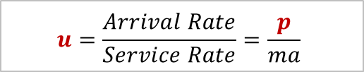
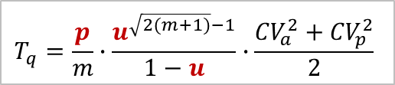
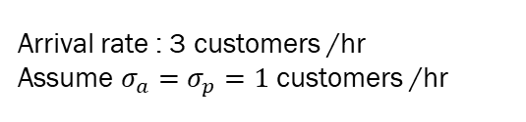
Explore the impact of parameters on waiting time
Service time
$$T_{q}=\frac{p}{m}∙\frac{u^{\sqrt{2(m+1)}−1}}{1−u}∙\frac{{CV}_{a}^{2}+{CV}_{p}^{2}}{2}$$
$$u=\frac{Arrival Rate}{Service Rate}=\frac{p}{ma}$$
Arrival rate : 3 customers /hr
Assume $σ_{a}=$ $σ_{p}=1$ customers /hr
Lesson 2
Shorter service time leads to shorter waiting time in the queue.
The decrease in expected waiting time is asymptotic, not linear.

Slide 47
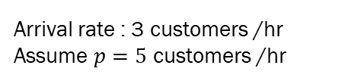
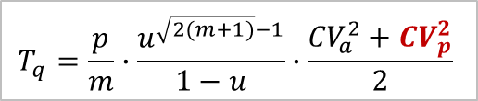
Explore the impact of parameters on waiting time
Service time variability
$$T_{q}=\frac{p}{m}∙\frac{u^{\sqrt{2(m+1)}−1}}{1−u}∙\frac{{CV}_{a}^{2}+{CV}_{p}^{2}}{2}$$
Arrival rate : 3 customers /hr
Assume $p=5$ customers /hr
Lesson 3
Expected customer waiting time decreases as variability decreases.

Slide 48
Explore the impact of parameters on waiting time
Increase in utilization
Utilization | Tq (min)
0.9999 | 12498.19
0.999 | 754.46
0.99 | 74.46
0.98 | 36.69
0.97 | 24.10
0.96 | 17.80
0.95 | 14.03
0.94 | 11.51
0.93 | 9.72
0.92 | 8.37
0.91 | 7.32
0.90 | 6.49
0.89 | 5.80
0.88 | 5.23
0.87 | 4.75
0.86 | 4.34
0.85 | 3.98
Lesson 4
As utilization approaches to 100%, waiting time goes to infinity
Managers cannot simultaneously achieve
near 100% utilization of servers, which minimizes operating cost, and
near zero waiting times, which improves customer experience.
There is a trade-off between low costs (high employee utilization) and high service quality (low customer waiting times).
Companies reduce this trade-off by lowering variability and improving customers’ waiting experience.

Slide 49
Explore the impact of parameters on waiting time
Pooling
Instead of having many small separate service lines, it is often better to combine them into one larger shared system.
For example:
One large hospital unit or one shared bank line is usually more efficient than many small separate units or lines.
In a pooled system, resources (beds, tellers, servers) can be shared among all customers.
Benefits of pooling:
Fewer total resources may be needed
Customers usually wait less
Variability is handled better because idle servers can help whoever is next in line

Slide 50
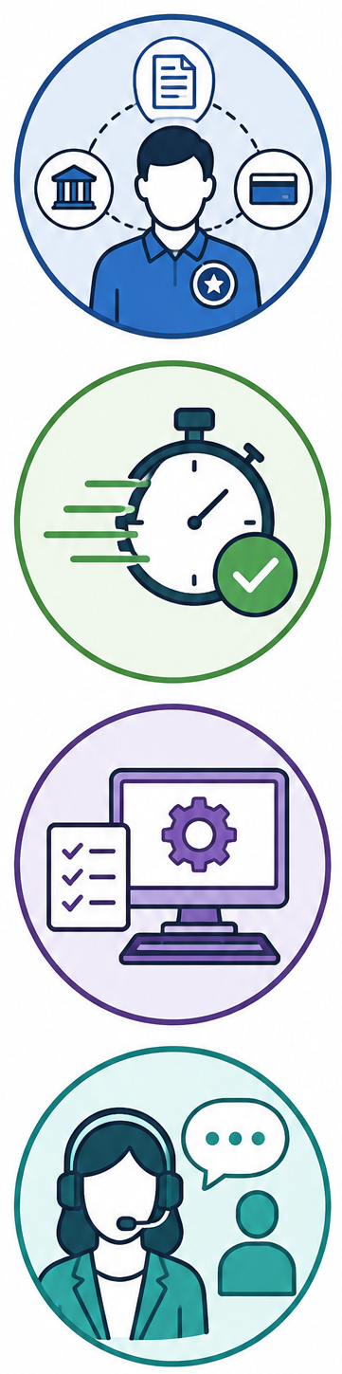
Explore the impact of parameters on waiting time
Wow — that sounds great!
Why does the bank have so many separate service counters?
Why don’t they combine all banking services into one large shared service line?
    Employees become experts in specific transaction types
    Service can become faster and more accurate
    Workstations, software, and procedures can be optimized for certain services
    Customers with complex needs may receive better support
However, in one large pooled line:
  Any teller serves any customer
  Customers may wait less overall because all tellers are shared
  But tellers constantly switch between different transaction types, which can slow them down or increase mistakes

Slide 51
Explore the impact of parameters on waiting time
Trade off
Shared lines reduce waiting times
Specialized tellers improve expertise and service quality
Option 1: Large Shared Service System
Any teller can help with deposits, loans, wire transfers, credit cards, etc.
Benefits:
Higher teller utilization (employees stay busy)
Lower operating cost
Shorter average customer waiting times because customers share one common line
Drawback:
Tellers may not be equally skilled in every transaction type
Complex services may take longer
Option 2: Specialized Service Counters
One desk only for mortgages
One for business banking
One for investments
Benefits:
Employees become experts
Transactions may be faster and more accurate
Better service quality for complex banking needs
Drawback:
Separate lines create variability
One counter may be overloaded while another is idle
Customers may wait longer overall

Slide 52
Explore the impact of parameters on waiting time
Trade off
Operations design always involves tradeoffs, and managers must choose what matters most
A bank cannot usually achieve all three at once:
Keep every teller busy 100% of the time
Have highly specialized banking experts
Have almost no customer waiting
For example:
Specialized mortgage advisors improve service quality
But customers may wait longer because only a few employees can handle those transactions
To solve this, banks may create a “flex team” or open extra counters during busy hours
High utilization
No waiting
High quality service

Slide 53
Simulation exercise about pooling

Slide 54
Explore the impact of parameters on waiting time
Ways to reduce arrival variability
Appointment systems: They don’t eliminate variability, they reduce the variability in arrival schedule
Influence the customer arrival process ASK GEMINI about examples Early bird specials, price discounts for hotels during off peak days, price discounts in transportation(air travel, highway tolls) depending on the time of service
Ways to reduce Processing Time Variability
Standardization both decreases processing time and the variability, which significantly decreases waiting time
Shorten processing time
Training
Technology
Variability in processing times frequently reflect quality problems. Rework

Slide 55
REFERENCES
Cachon, G., & Terwiesch, C. (2008). Matching supply with demand (Vol. 20012). New York: McGraw-Hill Publishing.
Fluxicon Tutorial : https://fluxicon.com/book/read/tutorial/
Goldratt, E. M., & Cox, J. (2016). The goal: a process of ongoing improvement. Routledge.
Link to Goal video - https://www.youtube.com/watch?v=t_oM9LvK0rU
Link to Mass Production vs One Piece Flow comparison video - https://www.youtube.com/watch?v=dmQORuNFE4c
Process mining - https://www.vdaalst.com/slides/Want-to-do-a-process-mining-project.pdf
Van Der Aalst, W. (2012). Process mining. Communications of the ACM, 55(8), 76-83.
Van der Aalst, W. M. P. (n.d.). Want to do a process mining project?

Slide 56
SUMMARY SLIDE

Slide 57
Elif Elcin Gunay

